Slide 1
Unsupervised Learning Capstone
Walmart Sales Data
By Sajit Gowthaman

Slide 2
Aim:
To analyze the sales data of Walmart.
To preprocess the sales data using Dimension Reduction algorithms by preserving 97% of the variance.
To apply Unsupervised Learning’s Clustering algorithms to the data.
To forecast the sales as a part of Kaggle’s competition.

Slide 3
Data:
We will be applying the unsupervised algorithms to the Selling Price Validation dataset.
It contains the sales data from day 1 to day 1913, Store ID, State ID, Item ID, Department ID, Category ID.
The shape of the data is 30,490 Observations and 1919 Features.

Slide 4
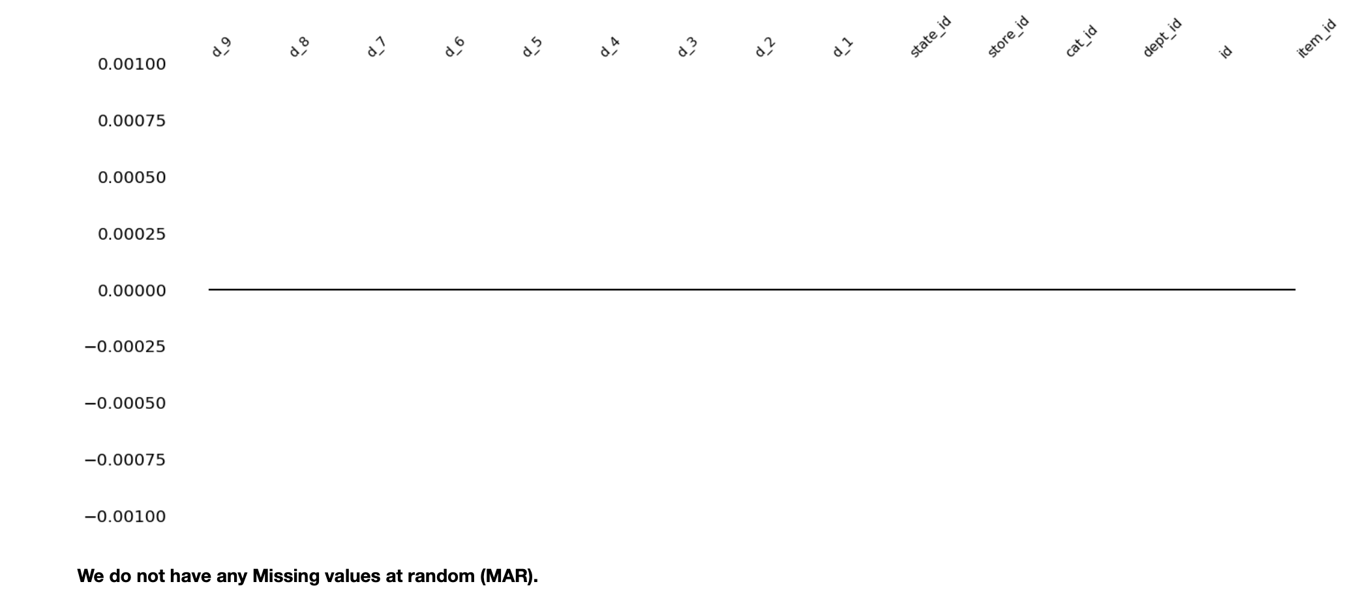
Exploring Data
Since the data is too big, the data has been subsetted to 15 columns.
Checked for MAR and found 0 missing values.

Slide 5
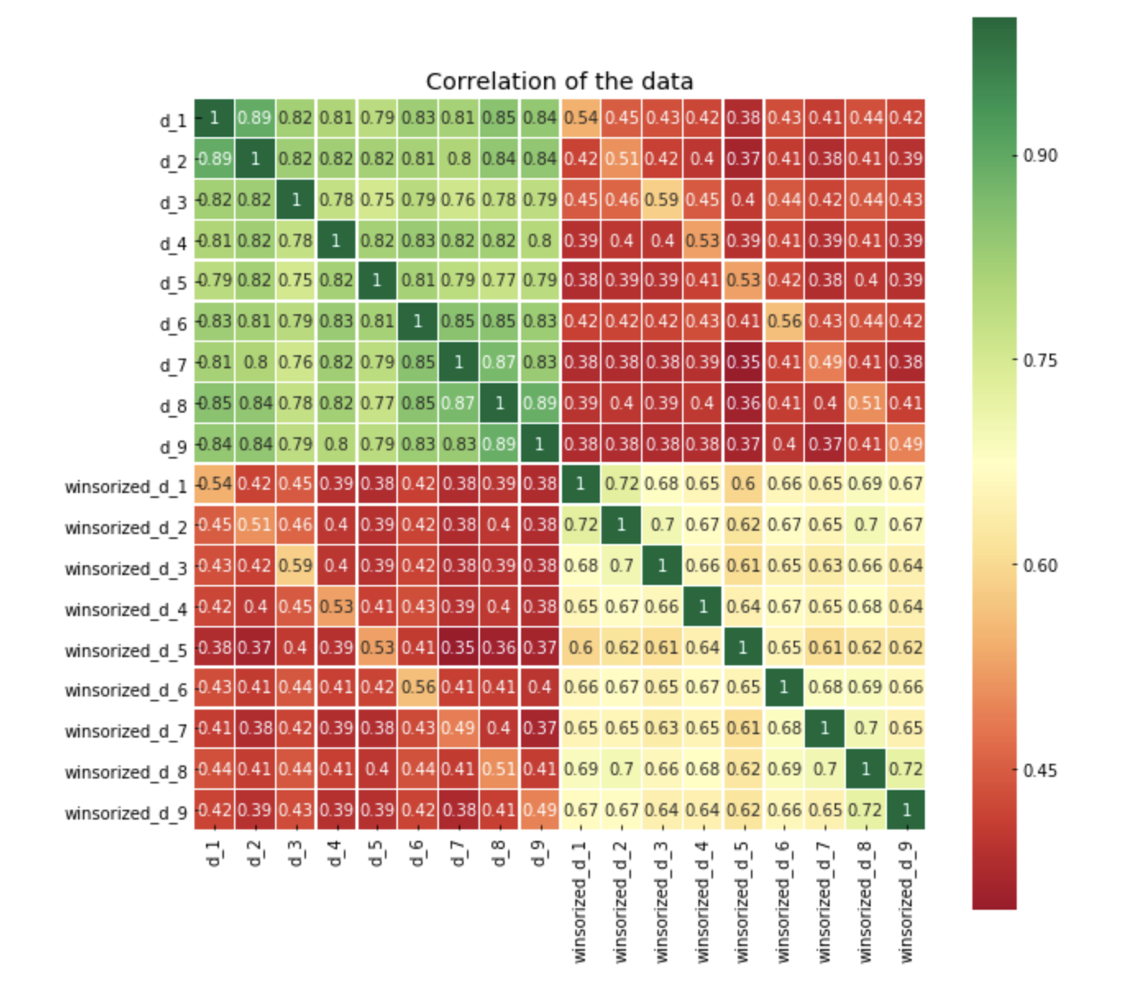
Heatmap
The heat map was plotted between winsorized and the normal days.
We can see few of the sales data like d_3 and d_8 are highly correlated.

Slide 6
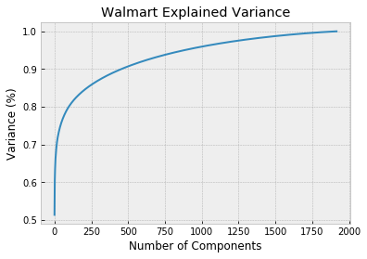
Explained Variance for preserving 97% variance

Slide 7
Dimension Reduction
Principal Component Analysis (PCA)
Preserved 97% of the data by plotting the explained variance
Reduced the features to 1250 from 1913
Implemented dynamic interactive plots
Explained variation per principal component: [5.13973346e-01 4.91358426e-02 4.16107277e-02 ... 4.87663044e-05
4.86297943e-05 4.84920679e-05]

Slide 8
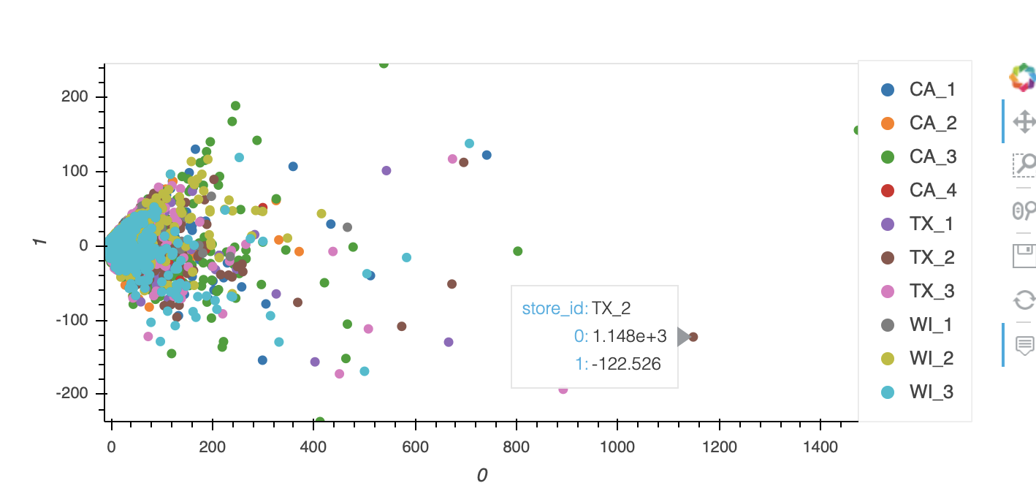
Visualization using Bokeh and Seaborn
With Bokeh:

Slide 9
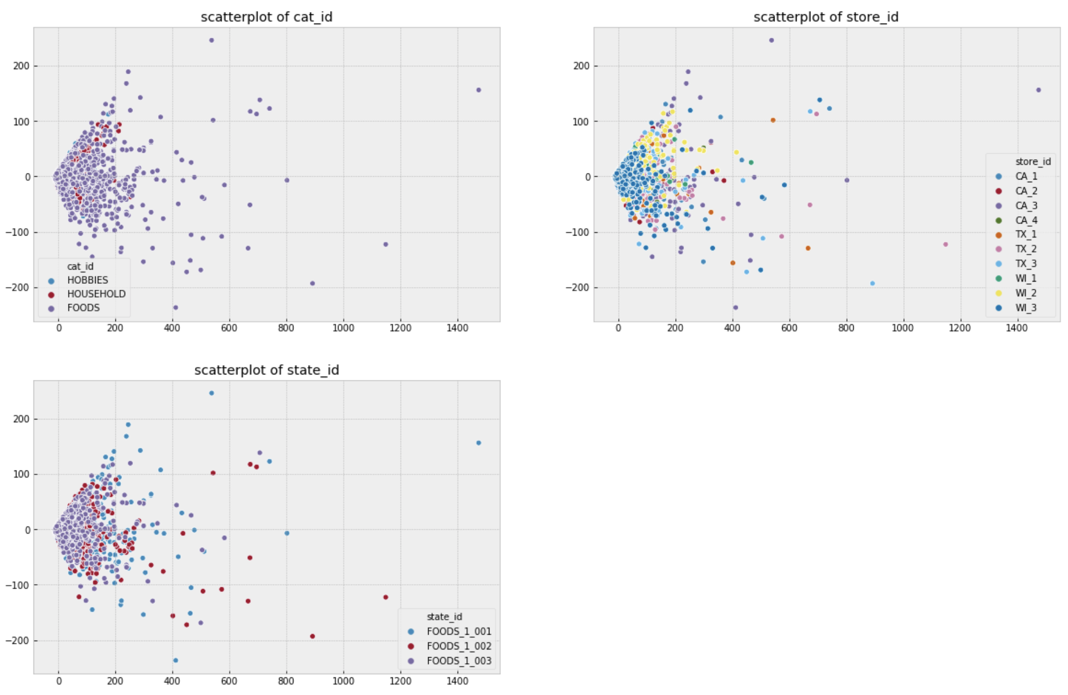
Seaborn Plot:

Slide 10
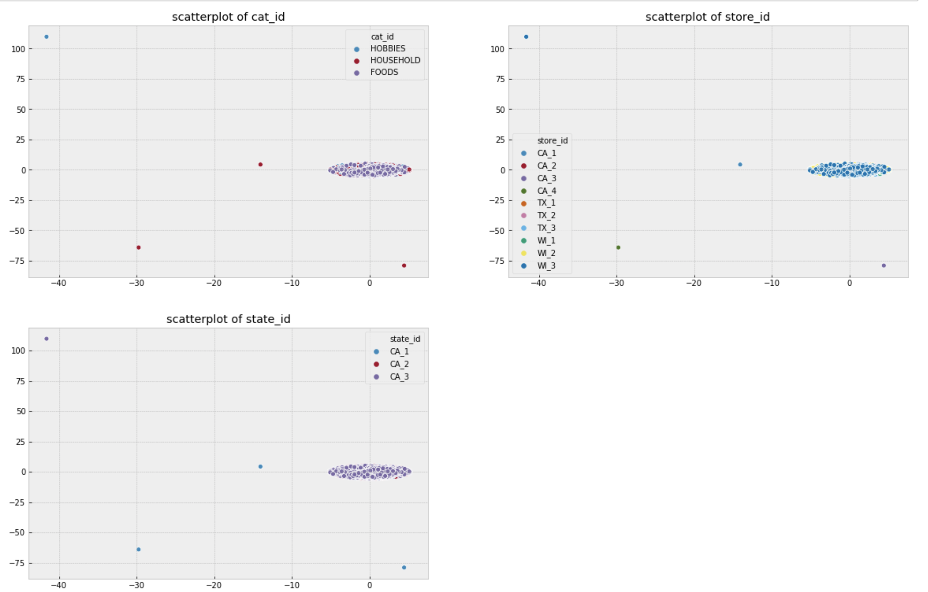
t-SNE Reduction Method
t-SNE is used to reduce large datasets down to 3 dimensions.

Slide 11
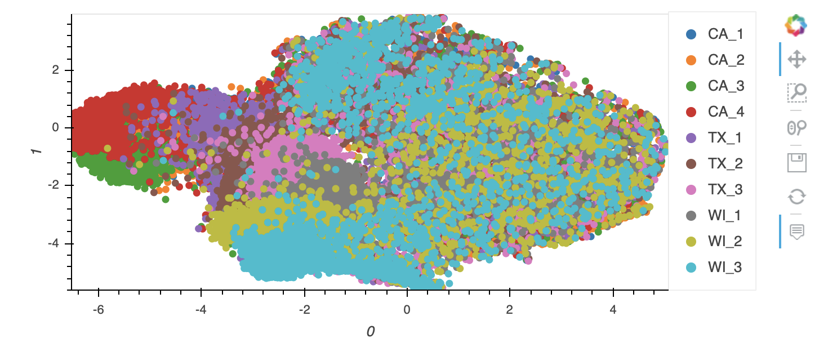
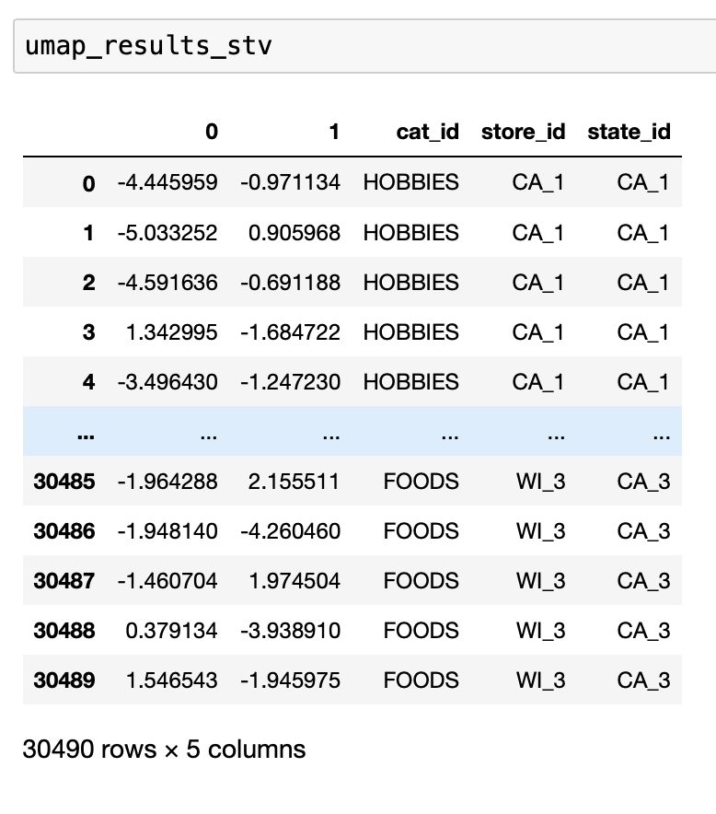
UMAP Reduction Method

Slide 12
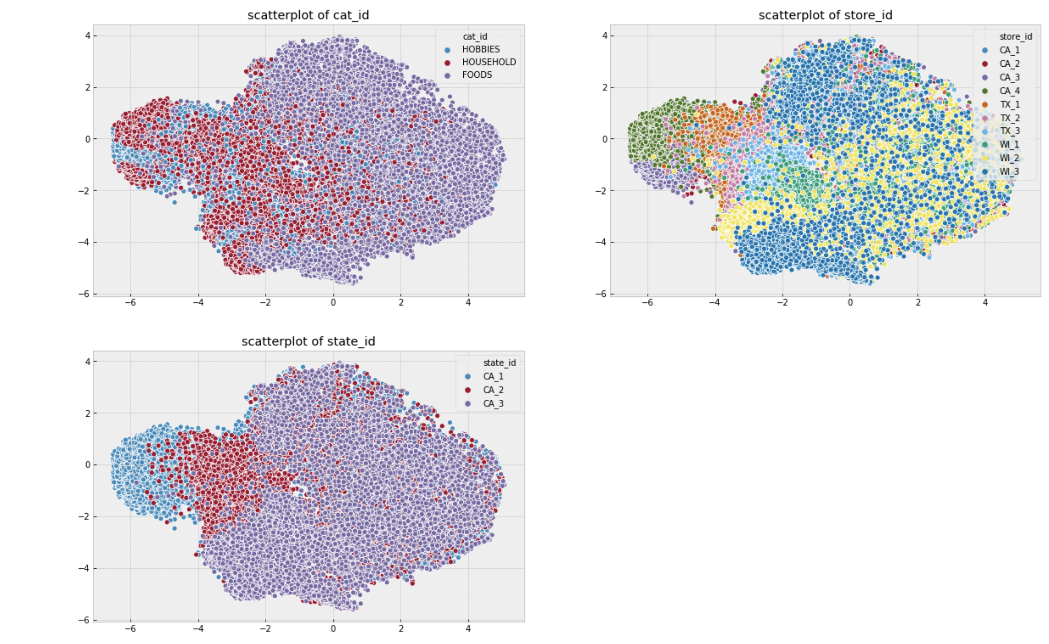
Seaborn Plots

Slide 13
Clustering
The clustering will be done with K-Means, DBSCAN, Agglomerative, GMM
The Clustering were evaluated with the silhouette scores.
The visualizations were performed by linking each clustering technique to the reduced dimensions.

Slide 14
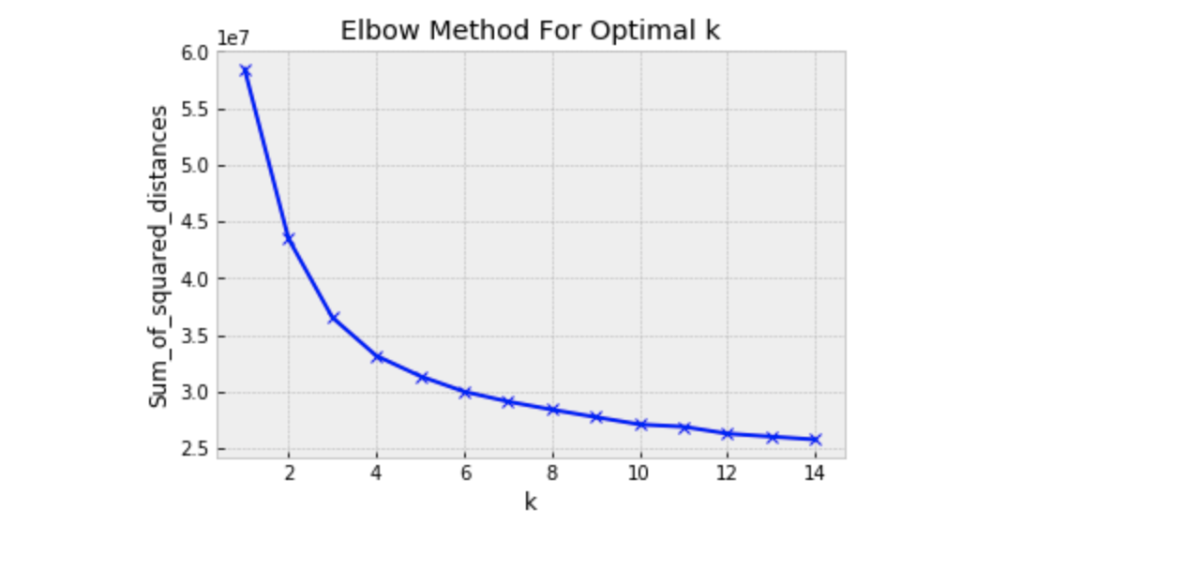
K-Means Clustering
Choosing number of cluster as 4 would be a good option as that is where the curve is starting to bend.

Slide 15
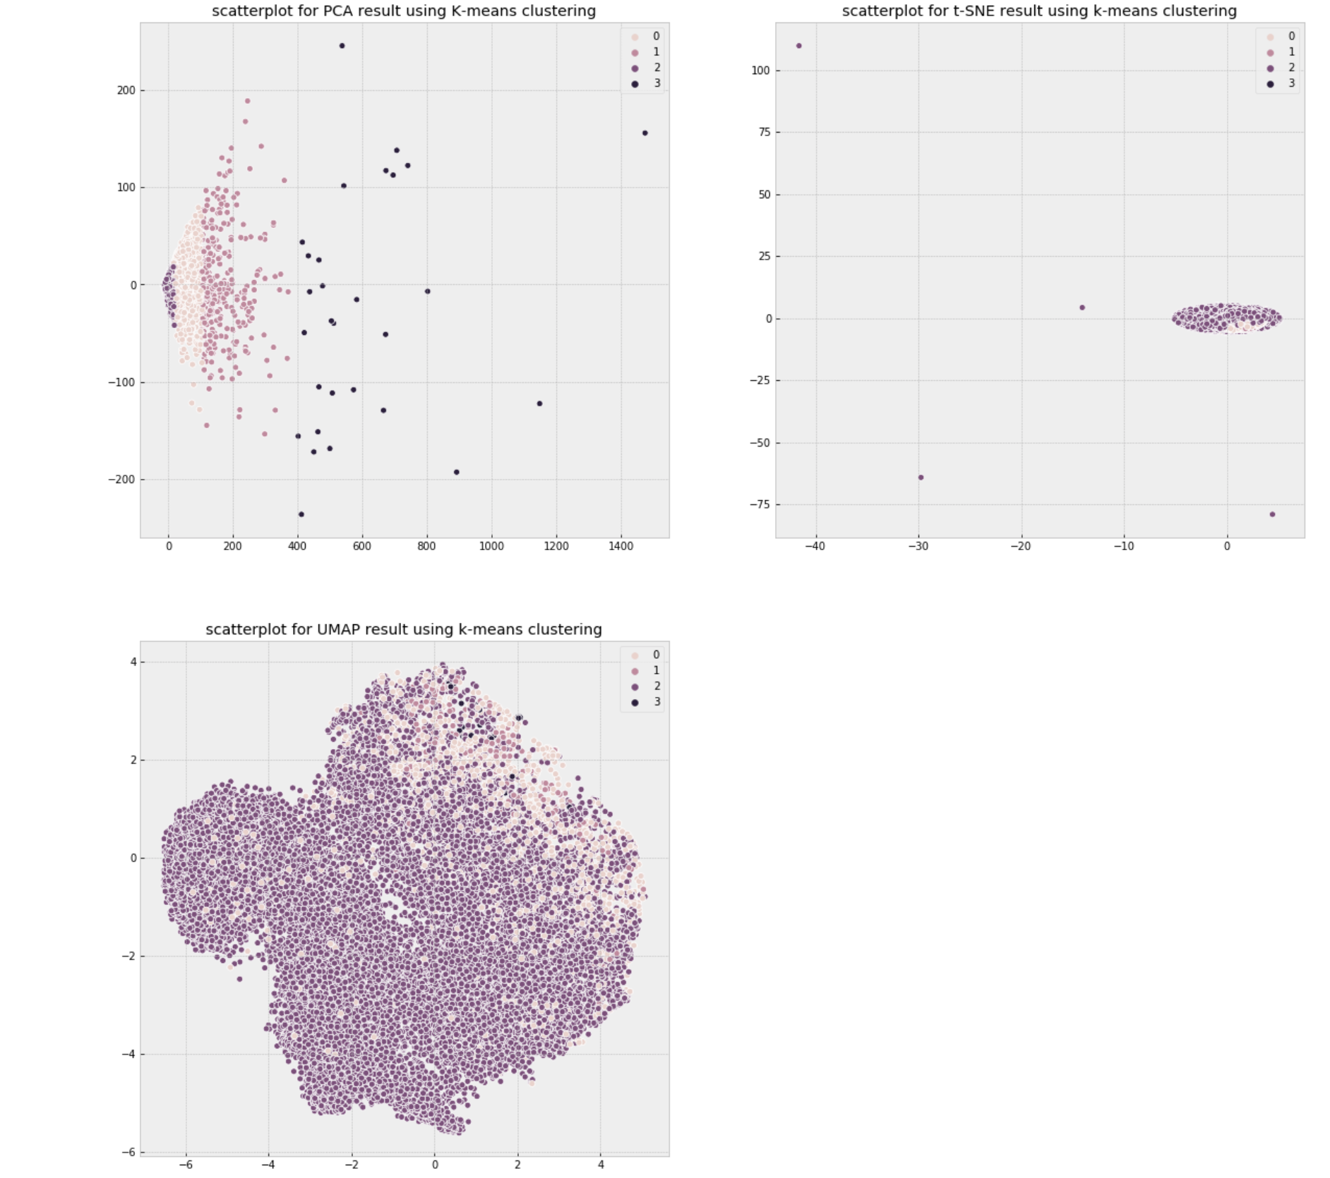
Visualization

Slide 16
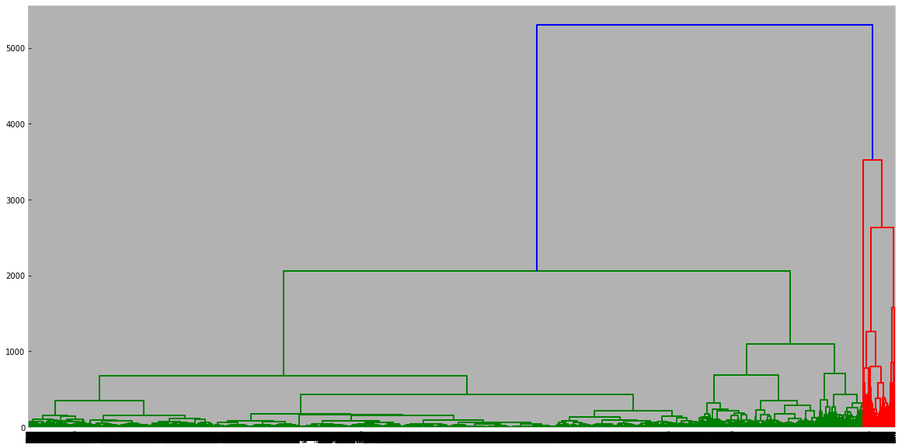
Hierarchical Agglomerative Clustering
The dendrogram was plotted using “ward” method.

Slide 17
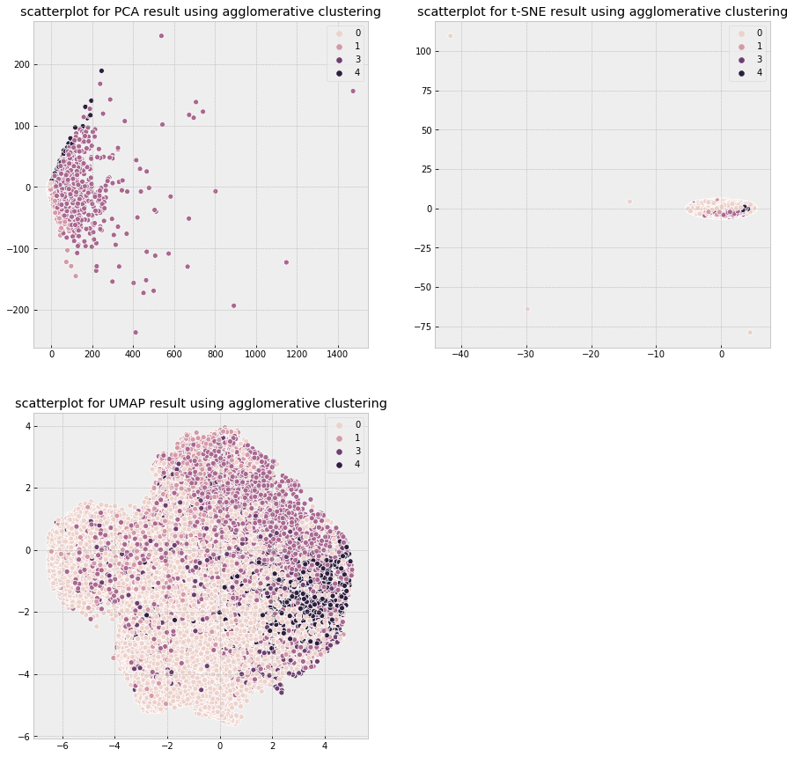
Visualization

Slide 18
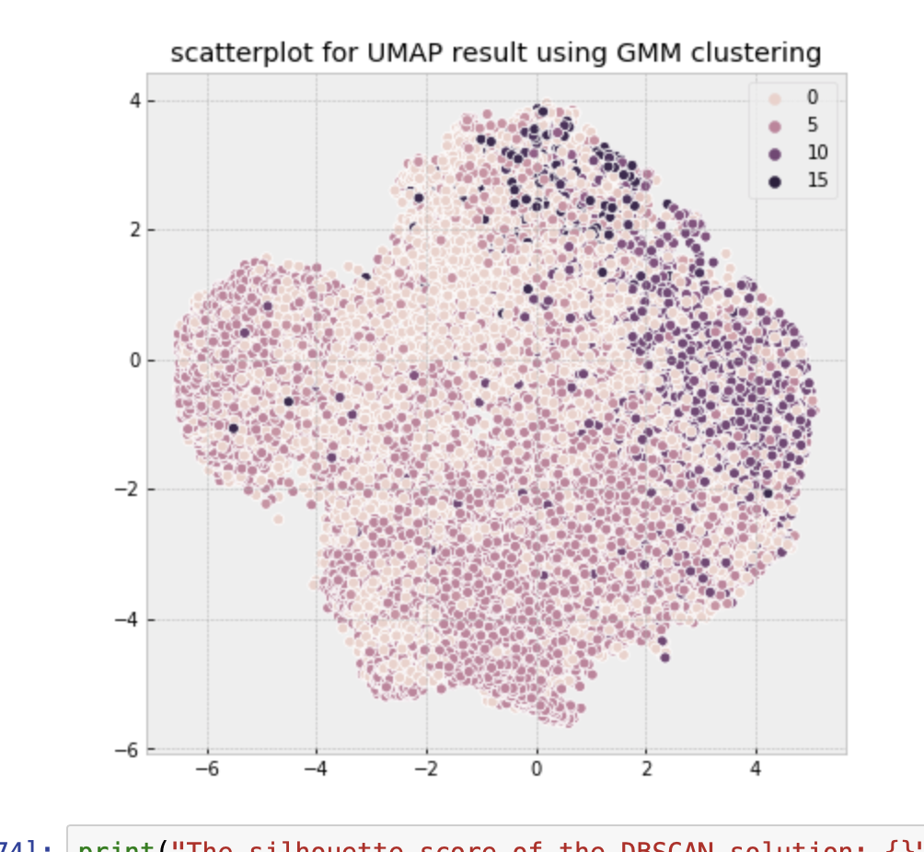
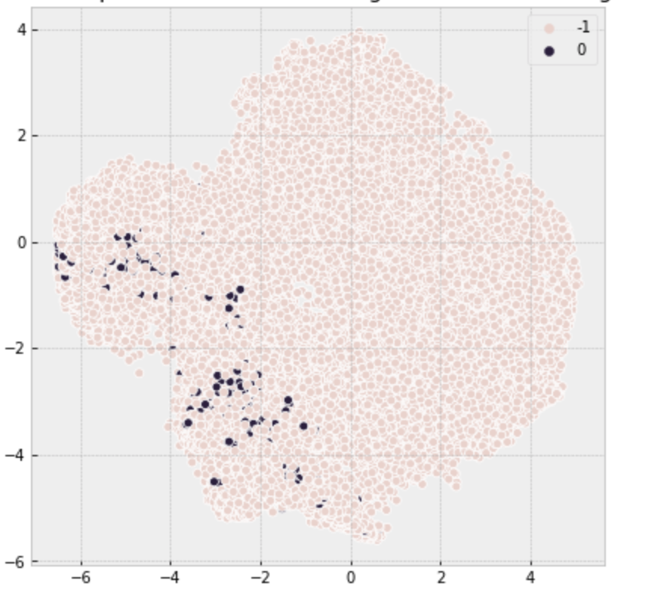
DBSCAN and GMM
Similarly they were done for DBSCAN and GMM clustering models.
Let’s just check one plot from each clustering for UMAP alone for simplicity.

Slide 19
Evaluation
Clustering Technique | Silhouette Score
K-Means | 0.663
Mini-Batch K-Means | 0.684
DBSCAN | -0.443
GMM | 0.165
Highest Silhouette Score | MiniBatch K-means = 0.684

Slide 20
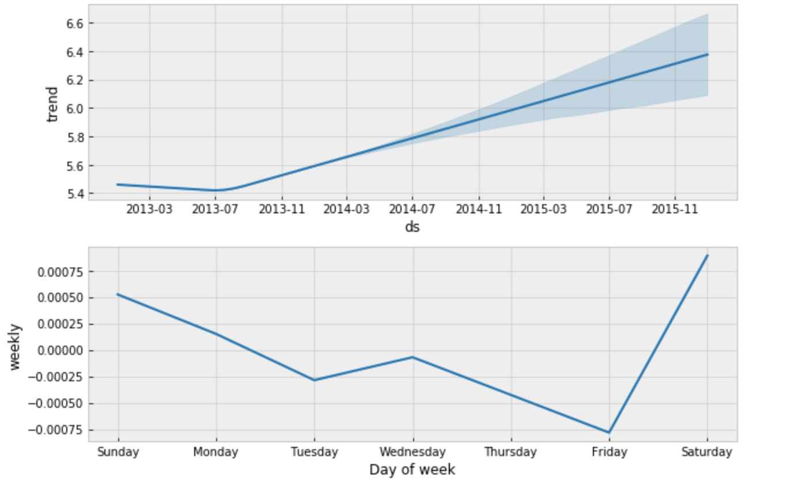
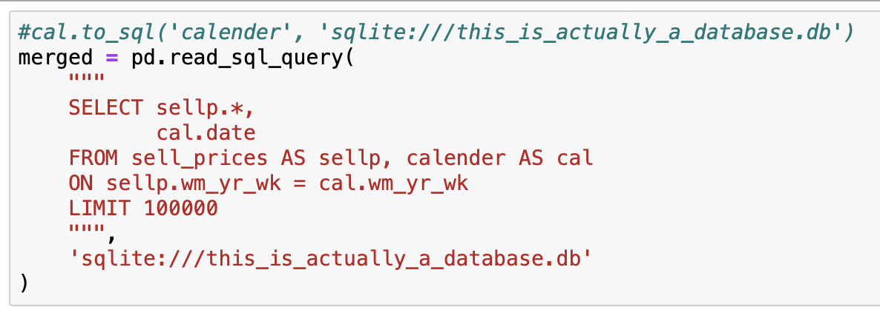
Forecasting Sales using FB Prophet
The sale price seem to increase down the years of forecast.

Slide 21
Challenges Faced
The runtime for each model was long because of the high number of features.
Multivariate and Univariate analysis could only be limited to a subset of data.
Similarly, the outliers detection was possible only for a subset of the data.

Slide 22
Conclusion
We were able to reduce the features from 1913 to 1250 using PCA, 3 using Tsne and 5 Umap without losing much variance
The data was clustered using unsupervised learning's clustering algorithms such as K-means, DBSCAN, GMM and Heirarchical agglomerative clustering (Linkage mechanism).
The data was plotted using Hvplot's Bokeh for dynamic visualization purpose.
The highest silhoutte score was achieved by MiniBatch K-Means with 68% Accuracy.
The sale price was merged to the calender for the year 2014 and forecasted with Facebook Prophet's forecasting model.

Slide 23
Thank you!

